Slide 1



Toward TCC
2012-2013 Senior Capstone Project
Computer Science Department
Texas Christian University
Matthew Bauer, Reid Mulkey, Jose Segura

Slide 2
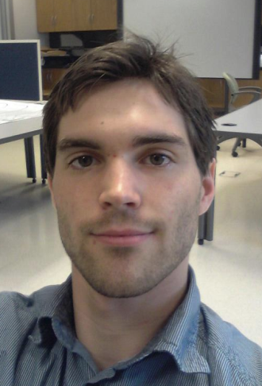
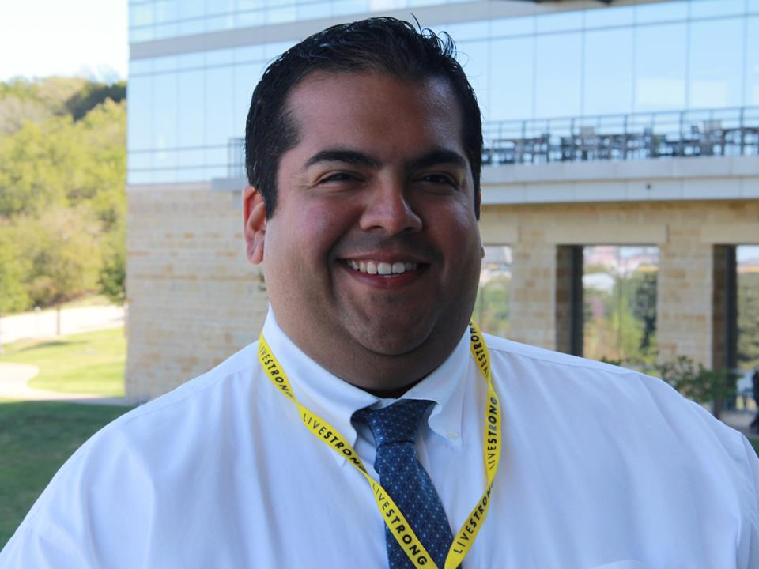
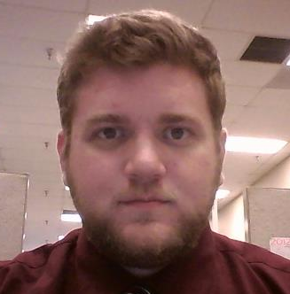
The Team
Matthew Bauer
Android Developer
Jose Segura
Web Designer
Reid Mulkey
iOS Developer

Slide 3
The Client
Tarrant County College (TCC) Web Communications Department
  Robert Heyser
  Susan Ragland
  Mark Crouch
  Brandon Tucker
TCC College Awareness Community Outreach (CACO) Program

Slide 4
The Problem
CACO distributes materials to area schools
  What to do in high school to prepare for college
  Application Information
  Education vs. Income correlation
A CACO application presenting this material
  The application includes additional tools
  Web, iOS, and Android platforms

Slide 5
Fall Semester 2012

Slide 6
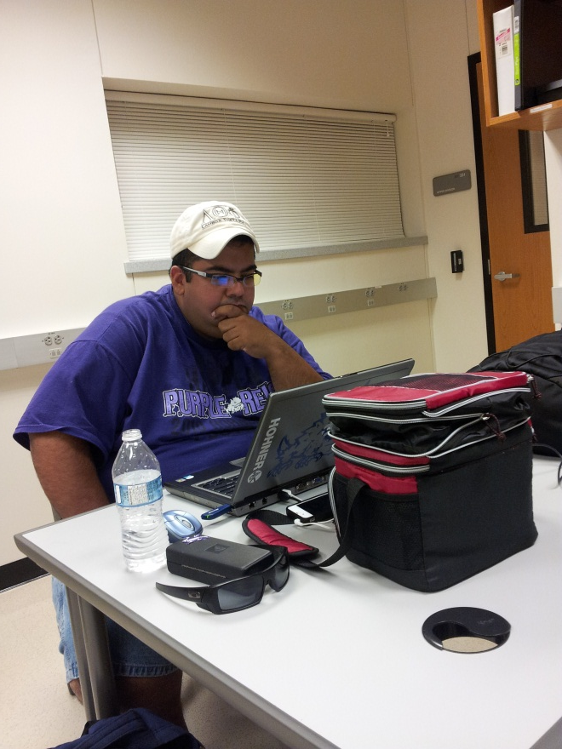
Fall Activities
Identified project
Project planning
  Schedule, roles, environment
Initial requirements
Initial design
Learned new technologies

Slide 7
The Environment
Support Environment Microsoft Office 2010 Camtasia Studio 2.2.0 Adobe Creative Suite 6 Core FTP 2.2 Subversion 1.7.7 Server Environment Windows Server 2008 SP2 | Web Development Environment HTML5, Sublime Text Editor 2 iOS Development Environment iOS 6.0, Xcode 4.6.2 IDE Versions 1.2.2 Android Development Environment Android SDK 7, Eclipse 4.2 Juno IDE

Slide 8
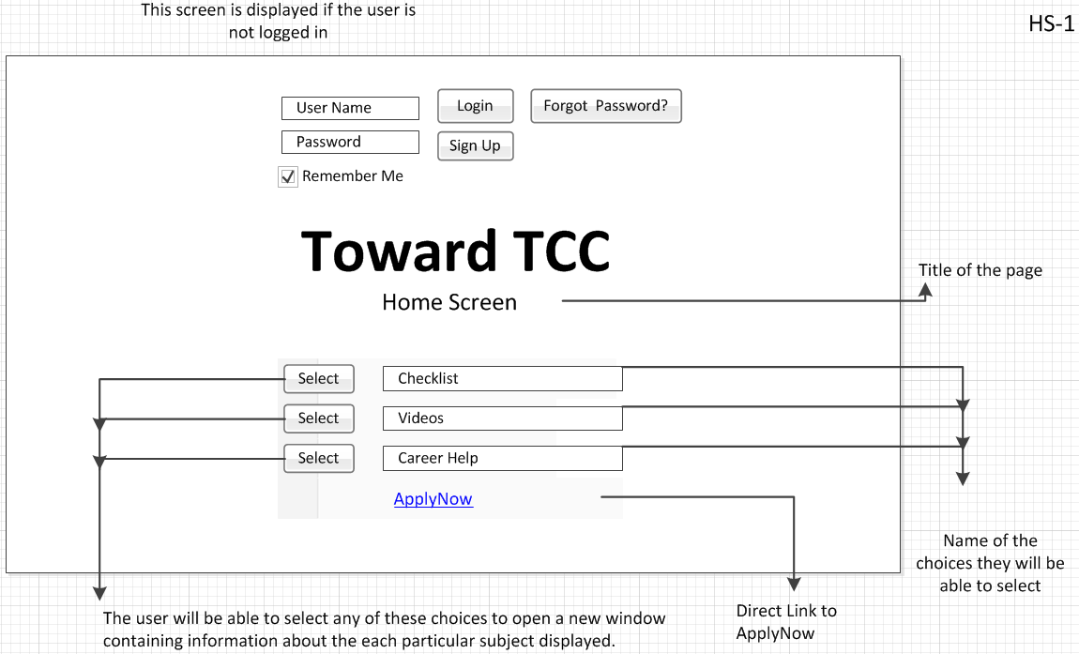
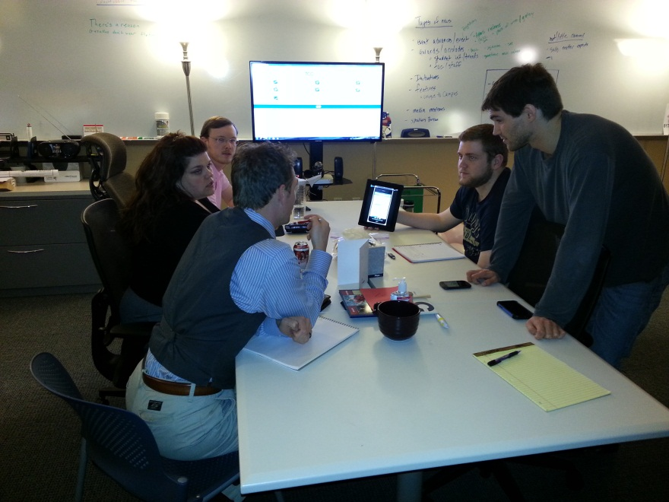
Requirements Gathering
Numerous meetings with clients
Developed wire frame prototype

Slide 9
General Requirements
Web application with information, videos, etc.
Android and iOS applications allowing user accounts and data storage
Notifications for approaching deadlines
User information cannot be made accessible to TCC, in accordance with FERPA

Slide 10
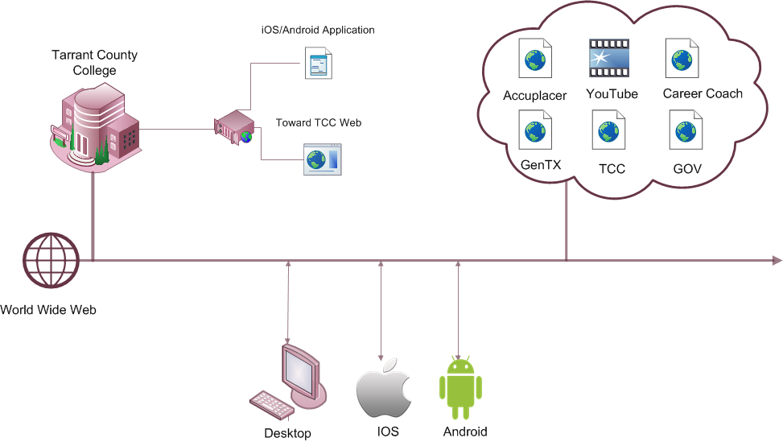
System Architecture

Slide 11
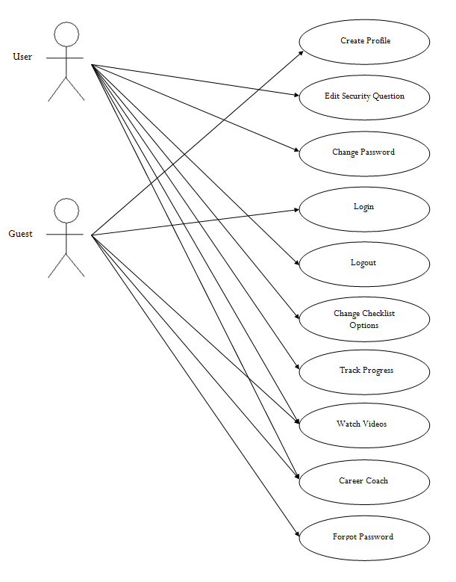
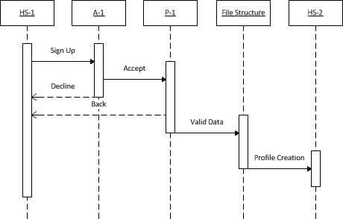
Design - UML Modeling
Use Cases
Sequence Diagrams
State Diagram

Slide 12
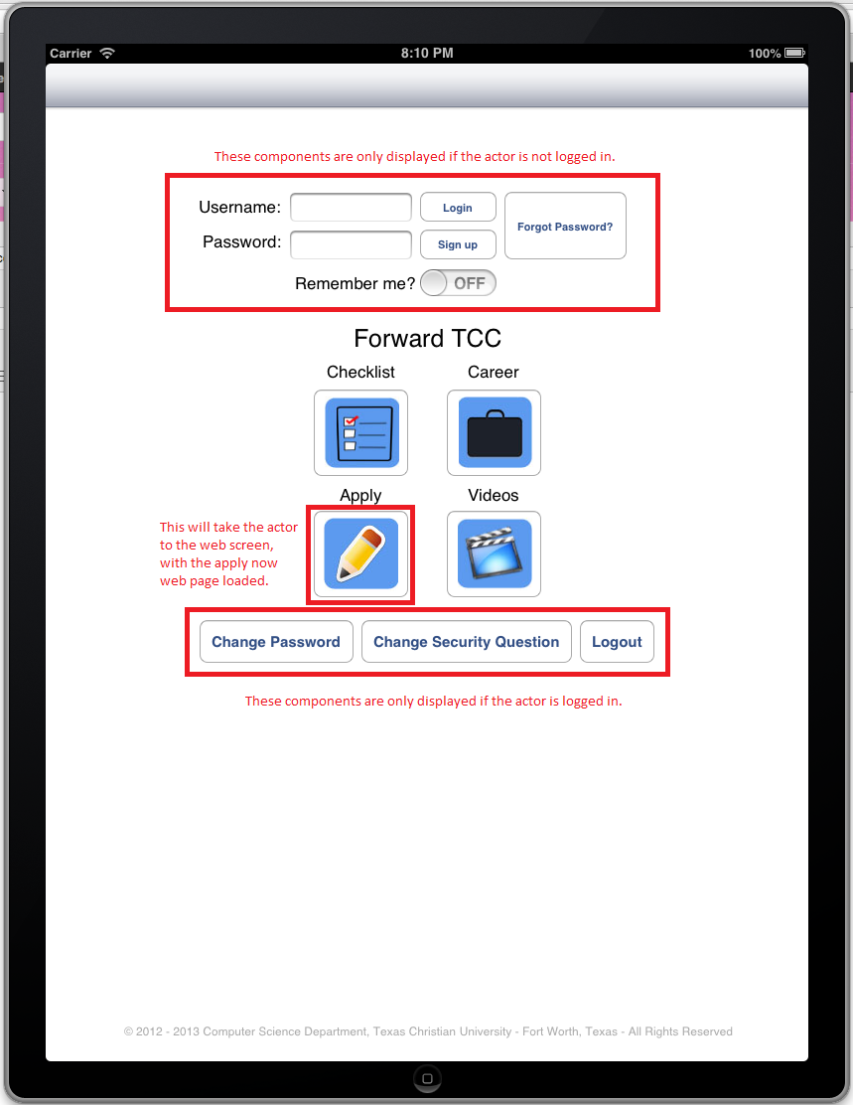
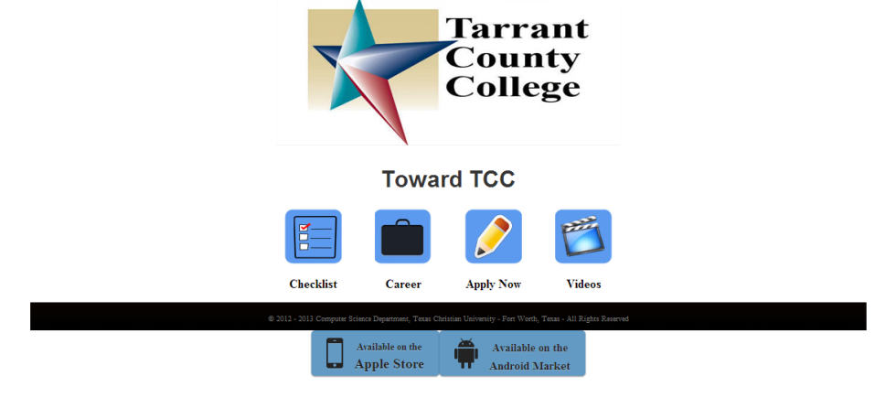
First Iteration (iOS & Web)

Slide 13
Spring Semester 2013

Slide 14
Spring Activities
Multiple iterations
  Design feedback
  Testing
  Documentation revisions
Additional documents
  User Manual
  Developer Manual
Presentations

Slide 15
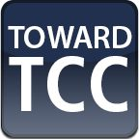




Graphic Design
Collaborated with TCC graphic designer
Created custom images
Assisted with application layout

Slide 16
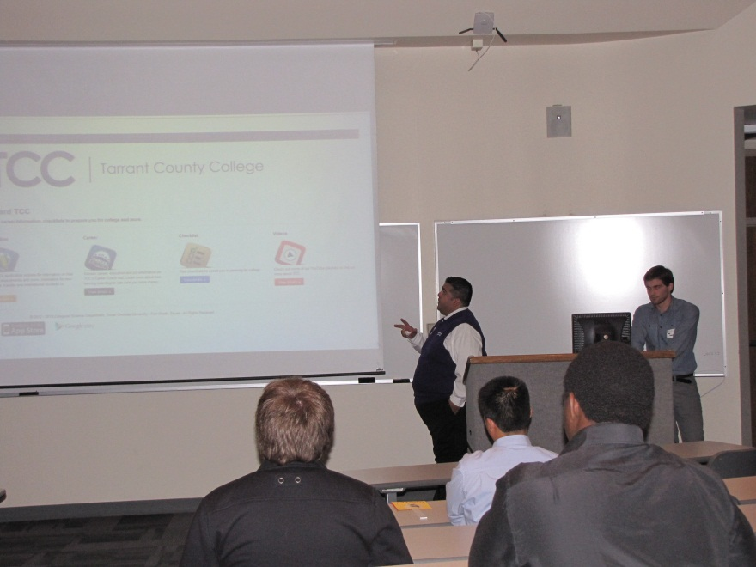
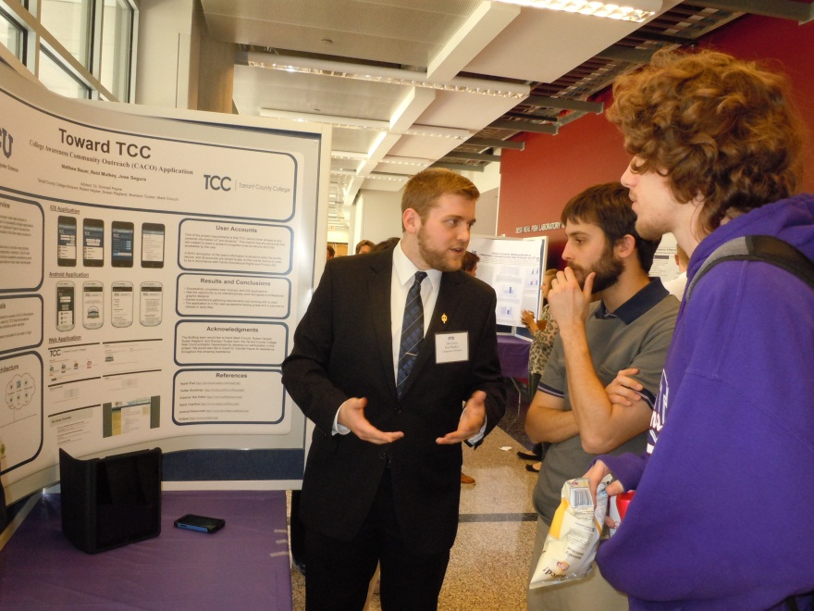
Presentations
North Texas Area Student Conference (NTASC)
Student Research Symposium (SRS)

Slide 17
Web Application

Slide 18



Web Application Development

Slide 19
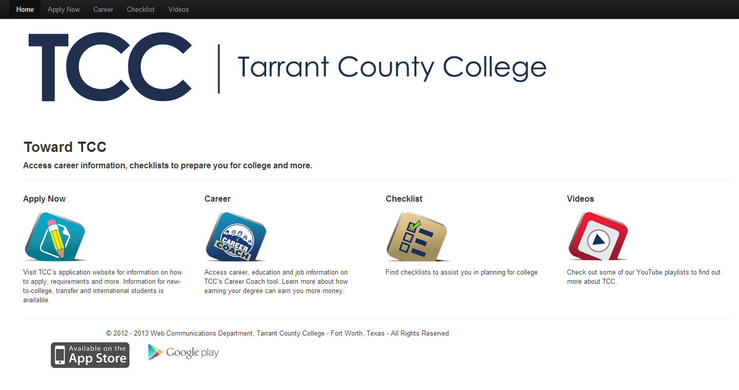
Home screen

Slide 20
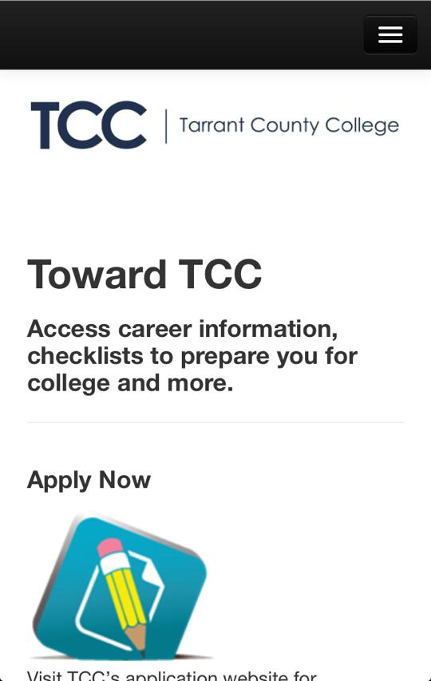
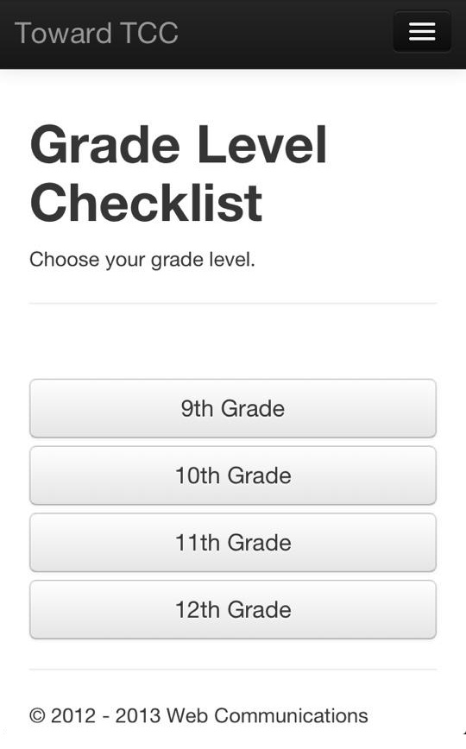
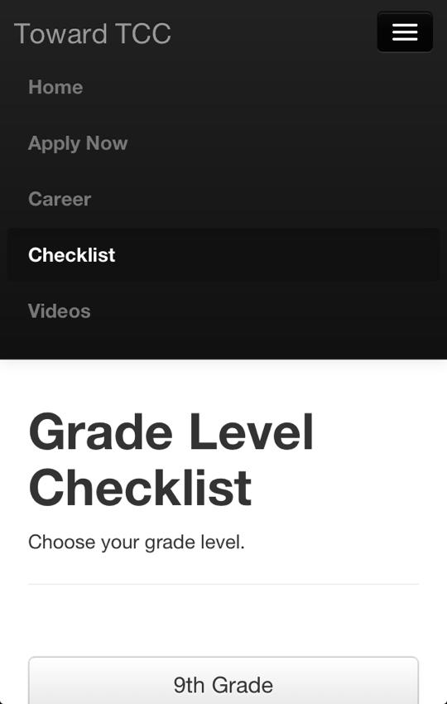
Responsive Design

Slide 21
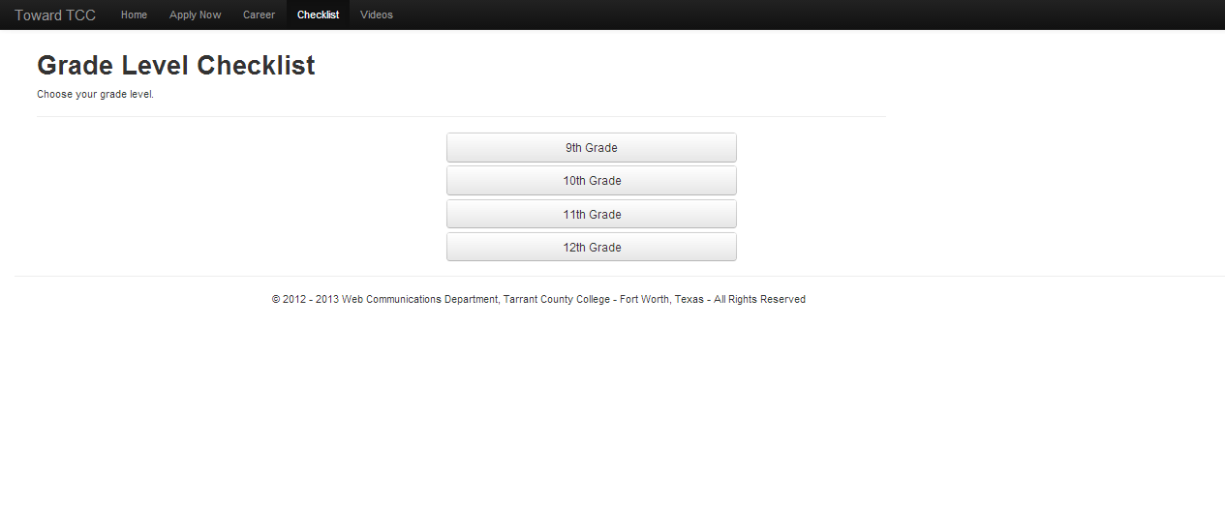
Checklist – Main Screen

Slide 22
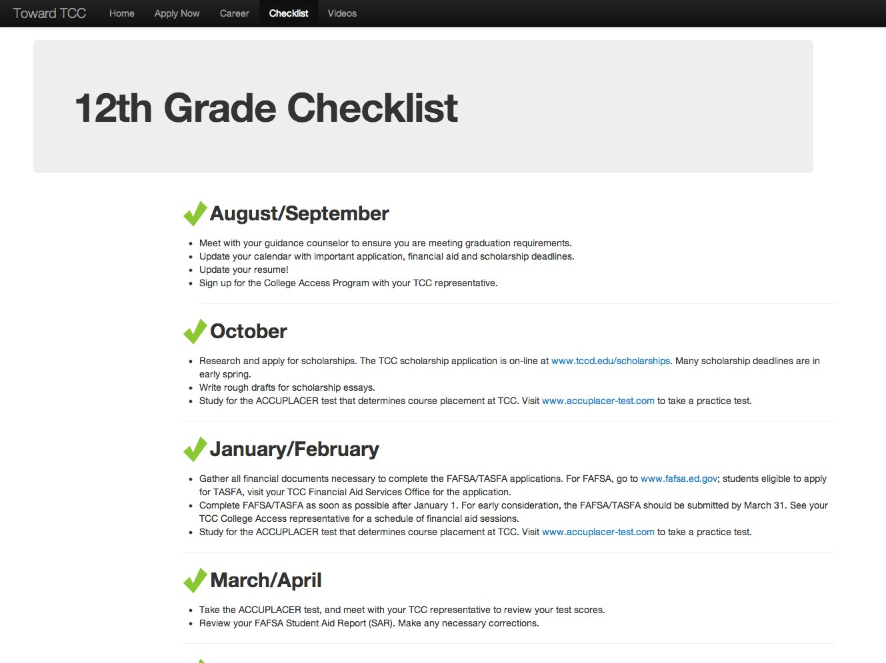
Checklist – Senior Year

Slide 23
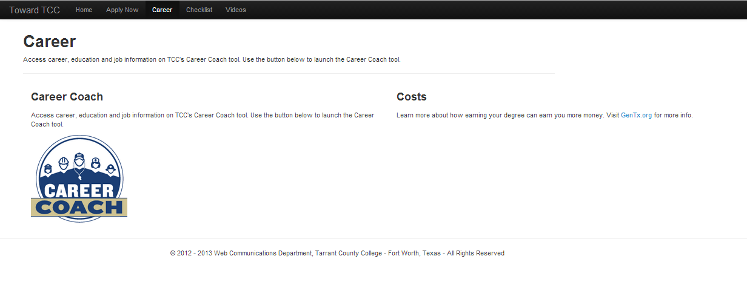
Career Screen

Slide 24
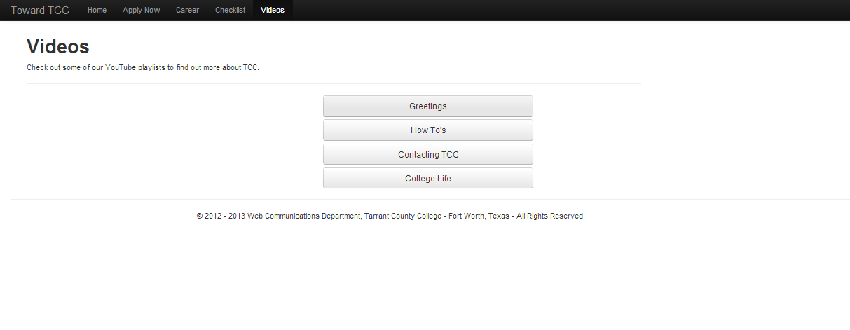
Video Screen

Slide 25
Mobile Applications

Slide 26
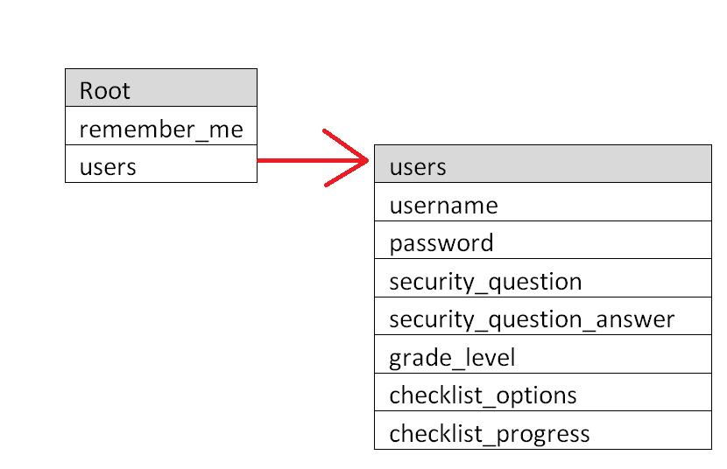
File Structure

Slide 27
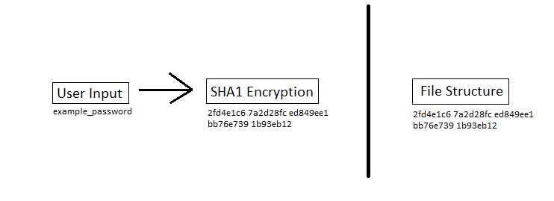
Data Encryption
For added security, the application does not store plain text values. Instead, it uses an encrypted representation.

Slide 28
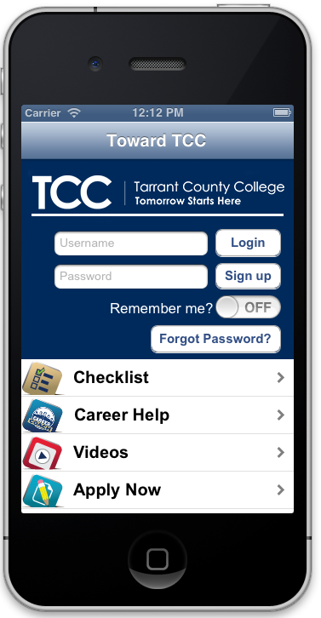
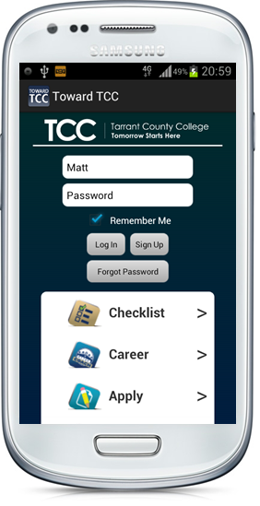
Home screen

Slide 29
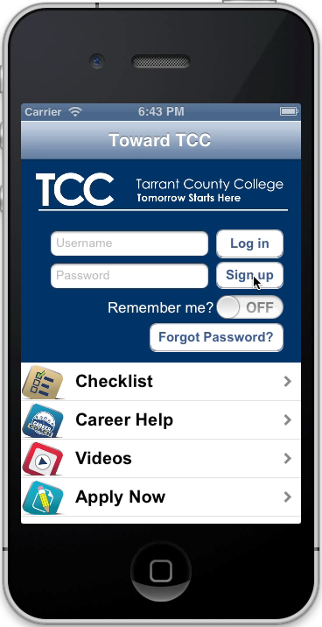
Creating a Profile

Slide 30
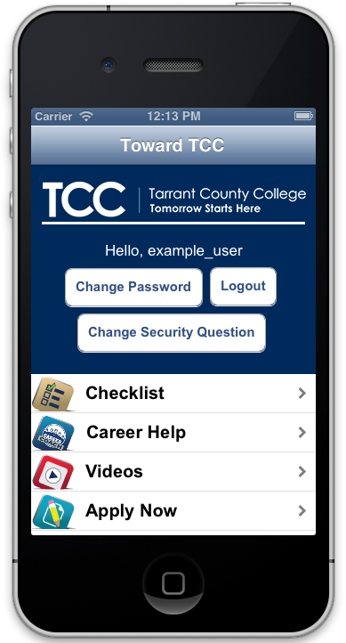
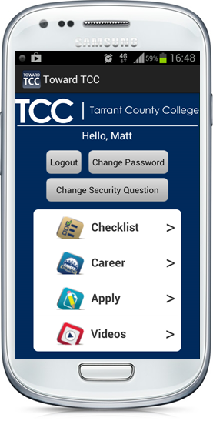
Home screen (logged in)

Slide 31
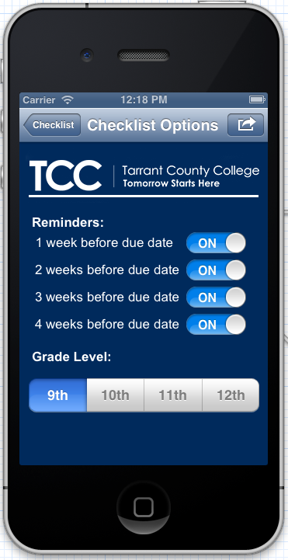
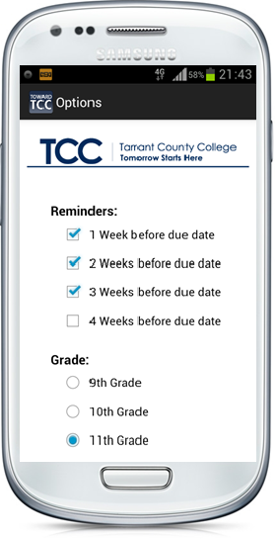
Checklist Options

Slide 32
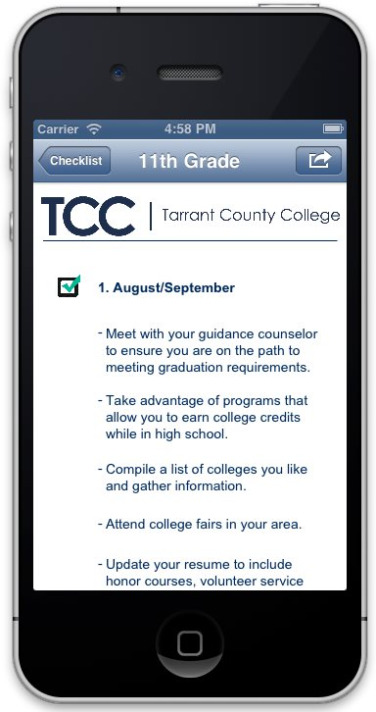
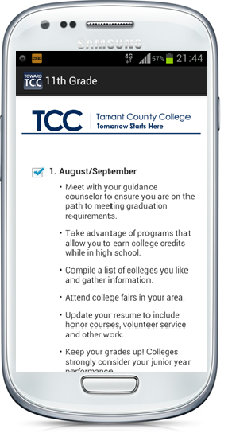
Checklist

Slide 33
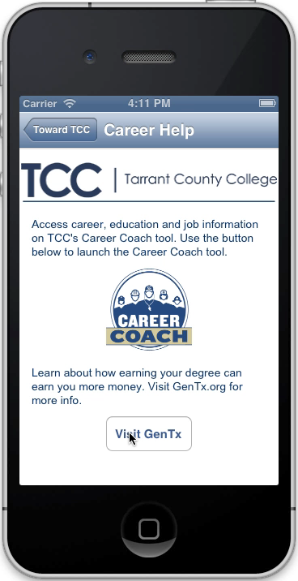
Web Browsing

Slide 34
Conclusion

Slide 35
Results
Successfully completed web, Android, and iOS applications
Gained experience with several new applications and techniques
The application is in the user acceptance testing phase and is planned to release in early May

Slide 36
Experiences
Had the opportunity to do interdisciplinary work alongside a professional graphic designer
Gained experience gathering requirements and working with an external client

Slide 37
Tips for Juniors
Always update your version. Always.
Learn the strengths and weaknesses of each team member, and divide work accordingly
Always keep communication flowing

Slide 38
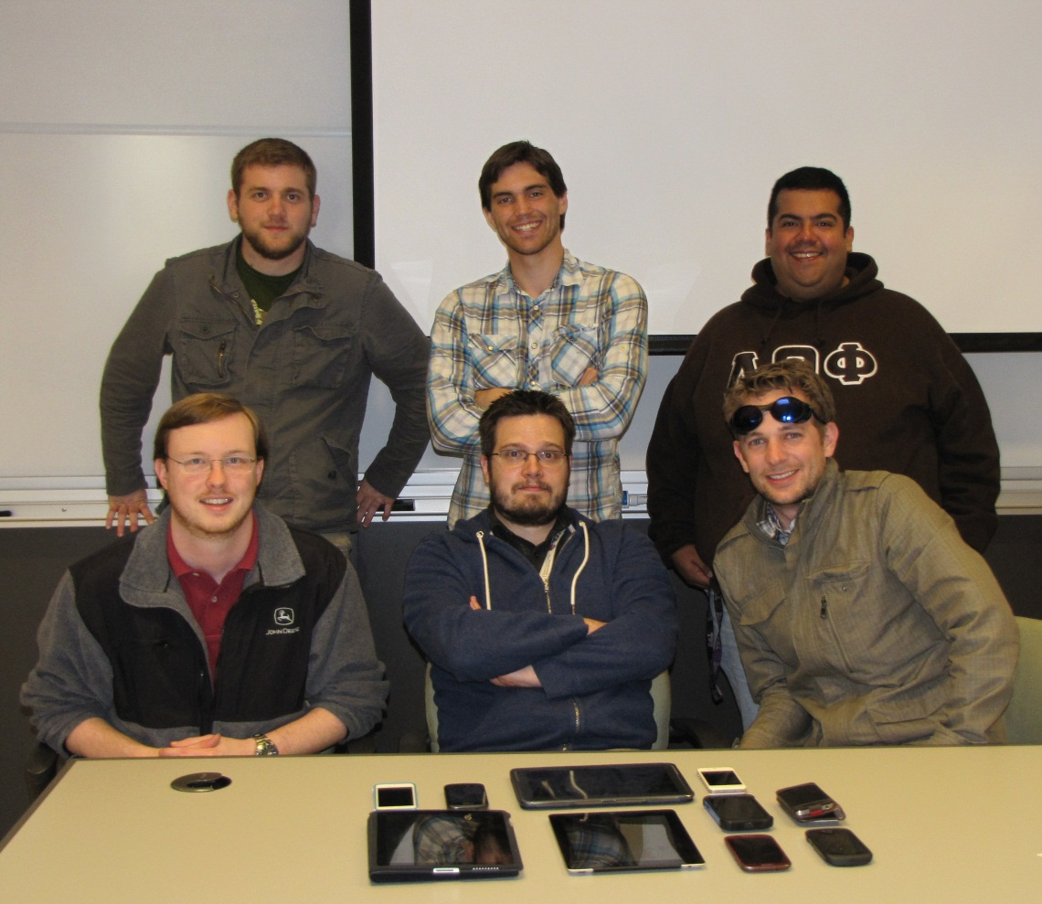
Acknowledgements
  We want to thank the staff at TCC and Dr. Payne
Susan Ragland
Robert Heyser
Mark Crouch
Brandon Tucker

Slide 39
Questions

